Slide 1

Dart Basics (session 1)
By : Mohamed Sayed

Slide 2
Agenda :
Intro to mobile applications (what is the difference between Native & Cross Platform).
Difference between Flutter & Dart.
History of dart.
Dart basics : Datatypes, Operators, Conditions, Loops, Function and Null Safety.

Slide 3
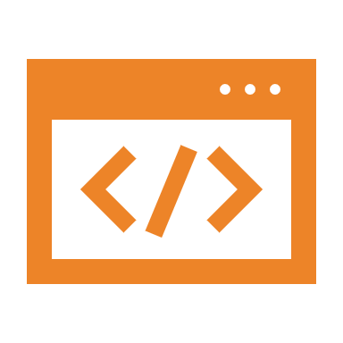
Intro to mobile applications (what is the difference between Native & Cross Platform)

Slide 4

Difference between Flutter & Dart
Dart is a modern(null safety , async programming ….) , object-oriented programming language. It is popular nowadays because of flutter. It is difficult to build complete apps only using Dart because you have to manage many things yourself.
Flutter is a framework that uses dart programming language. With the help of flutter, you can build apps for android, iOS, web, desktop, etc. The framework contains ready-made tools to make apps faster.

Slide 5

History of dart
Google developed Dart in 2011 as an alternative to javascript.
Dart 1.0 was released on November 14, 2013.
Dart 2.0 was released in August 2018.
Latest version of dart is 3.1.5
Dart gained popularity in recent days because of flutter.

Slide 6
Dart basics
Let’s to code ??

